Slide 1

Normalization and Other Data Modeling Methods
There are many paths to the top of the mountain but the view is always the same
Chinese proverb

Slide 2
Normalization
An alternative database design tool to data modeling
A theoretical foundation for the relational model
Application of a series of rules that gradually improve the design

Slide 3
Functional dependency
A relationship between attributes in an entity
  One or more attributes determine the value of another attribute
An identifier functionally determines all the attributes of an entity
  stock code → firm name, stock price, stock quantity, stock dividend
  If we know stock code we know the value of firm name, etc.
Multivalued dependency
Formulae
  (stock dividend, stock price) → yield

Slide 4
Full functional dependency
Yield is fully functionally dependent on stock dividend and stock price because both of these attributes are required to determine the value of yield
  (stock dividend, stock price) → yield
Determinant
  An attribute that fully functionally determines another attribute
    e.g., stock code determines stock PE

Slide 5
Multidetermination
A given value can determine multiple values
  A multidetermines B
  A → → Β
  e.g., Department multidetermines course
Multivalued dependency means functional dependencies are multivalued

Slide 6
Attribute relationships
one-to-one
  a value of an attribute determines the value of another attribute and vice versa
  A → B and B → Α
  e.g.,
    CH → Switzerland
    Switzerland → CH

Slide 7
Attribute relationships
one-to-many
  a value of one attribute determines the value of another attribute but not vice versa
  A → B
  e.g.,
    country name → currency unit
    currency unit not → country name

Slide 8
Attribute relationships
many-to-many
  neither attribute determines the other
  A not → B
  B not → A
    country name not → language
    language not → country name
      French and Flemish is spoken in Belgium
      French is spoken in many countries

Slide 9
Normal forms
A classification of relations
Stacked like a set of Russian dolls
  Innermost is first normal form

Slide 10
First normal form (1NF)
All rows must have the same number of columns
Single valued attributes only

Slide 11
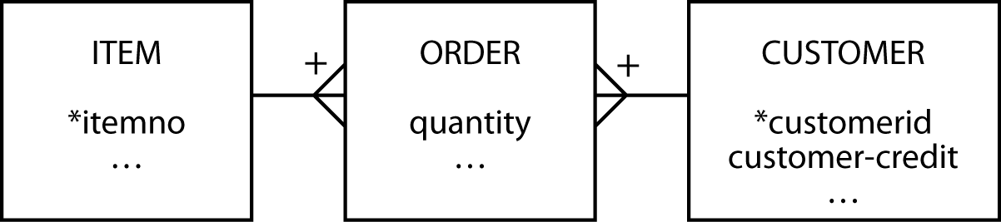
Second normal form (2NF)
Violated when a nonkey column is a fact about part of the primary key
A column is not fully functionally dependent on the primary key
  customer-credit in this case
order
itemno | customerid | quantity | customer-credit
12 | 57 | 25 | OK
34 | 679 | 3 | POOR

Slide 12
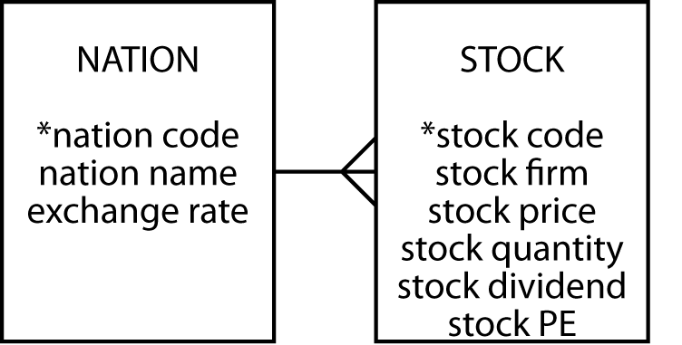
Third normal form (3NF)
Violated when a nonkey column is a fact about another nonkey column
A column is not fully functionally dependent on the primary key
  EXCHANGE RATE in this case
stock
stock code | nation | exchange rate
MG | USA | 0.67
IR | AUS | 0.46

Slide 13
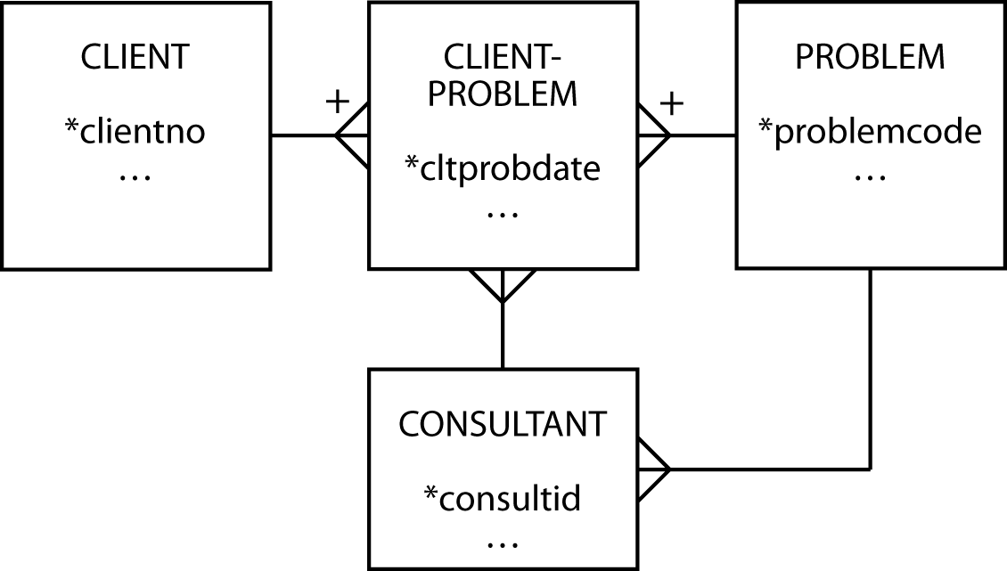
Boyce-Codd normal form (BCNF)
Arises when a table
  has multiple candidate keys
  the candidate keys are composite
  the candidate keys overlap
advisor
client | probtype | consultant
Alpha | Marketing | Gomez
Alpha | Production | Raginiski

Slide 14
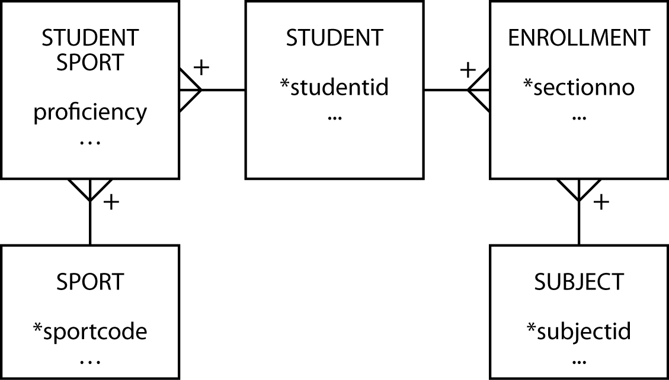
Fourth normal form (4NF)
A row should not contain two or more multivalued independent facts
student
studentid | sport | subject | …
50 | Football | English | …
50 | Football | Music | …
50 | Tennis | Botany | …
50 | Karate | Botany | …

Slide 15
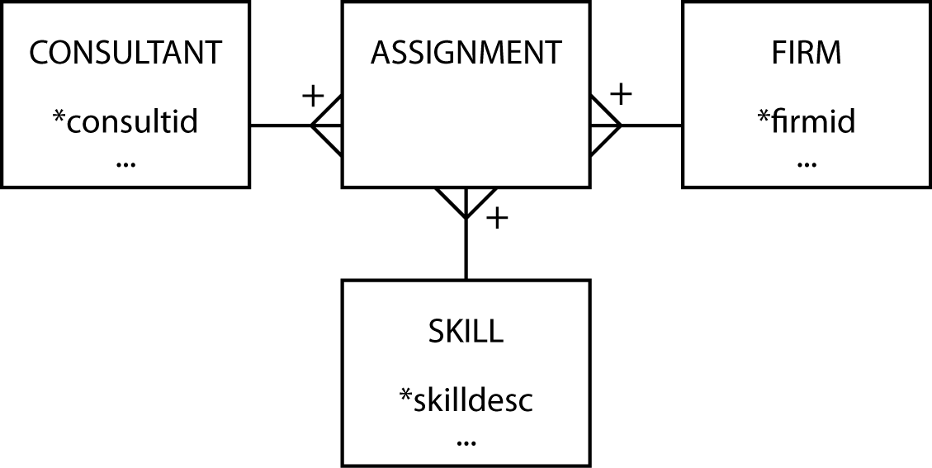
Fifth normal form (5NF)
A table can be reconstructed from other tables
There exists some rule that enables a relation to be inferred
Base case
  Consultants provide skills to one or more firms and firms can use many consultants; a consultant has many skills and a skill can be used by many firms; and a firm can have a need for many skills and the same skill can be required by many firms

Slide 16
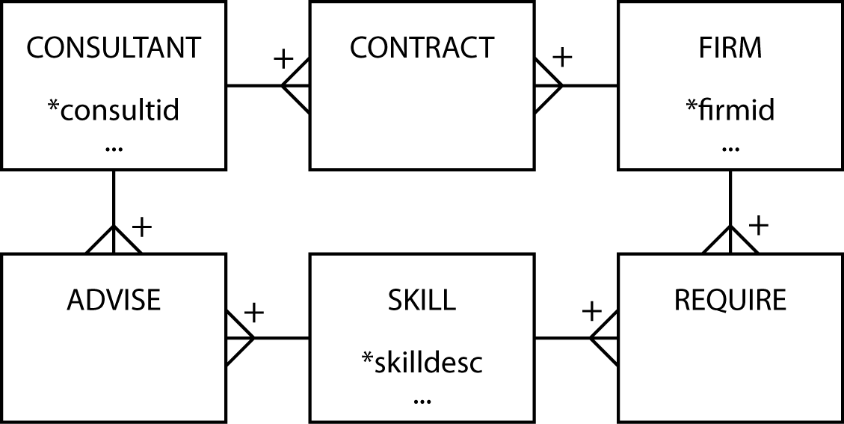
Fifth normal form (5NF)
The rule
  If a consultant has a certain skill (e.g., database) and has a contract with the firm that requires that skill (e.g., IBM), then the consultant advises the firm on that skill (i.e., he advises IBM on database)

Slide 17
Domain key/ normal form (DK/NF)
Key: unique identifier
Constraint: rule governing attribute values
Domain: set of values of the same data type
Every constraint on the relation must be a logical consequence of the domain constraints and the key constraints that apply to the relation

Slide 18
Data modeling and normalization
Data modeling is often an easier path to good database design
A high-fidelity data model will be of high normal form
5NF is likely to create the most problems
  Check for special rules

Slide 19
Data modeling methods
The most widely known model is Chen's entity-relationship (E-R) approach
There is no standard for the E-R method
Nearly all data modeling approaches are very similar because they share common concepts
Learning is readily transferable between methods

Slide 20
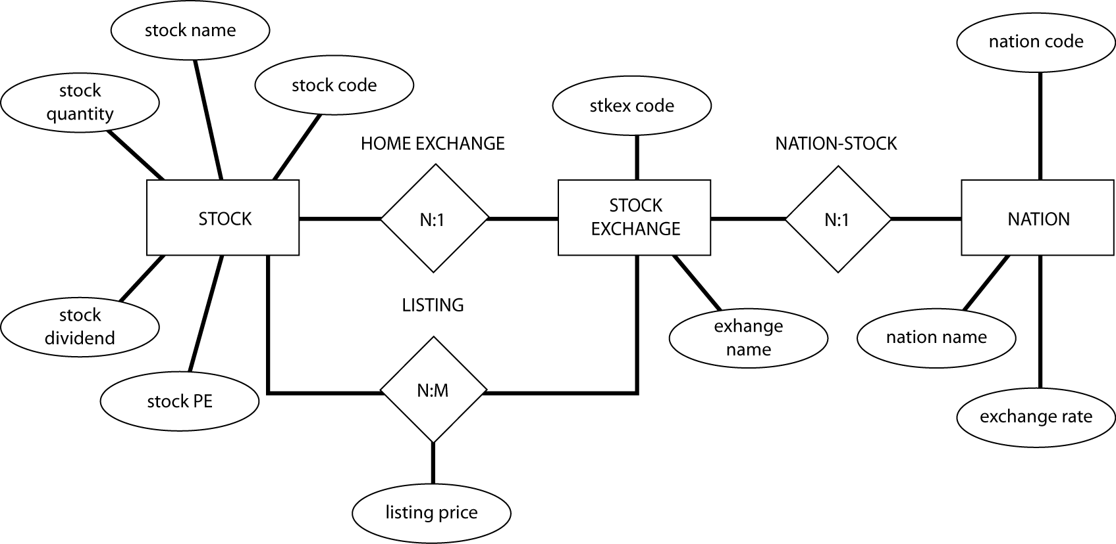
An E-R diagram

Slide 21
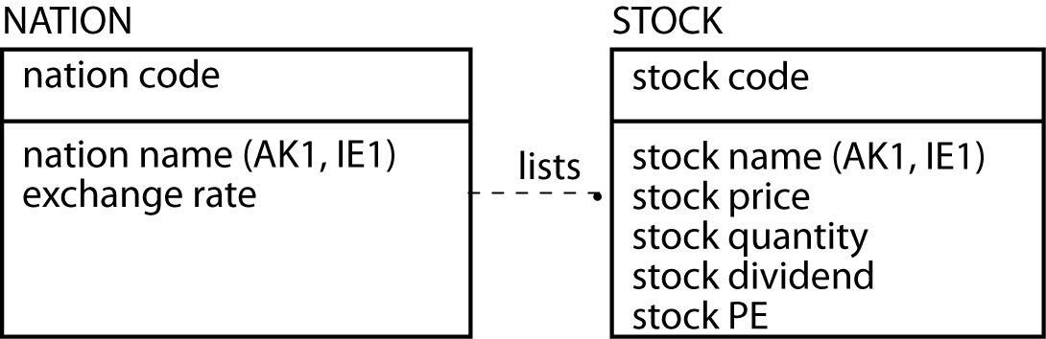
IDEF1X

Slide 22
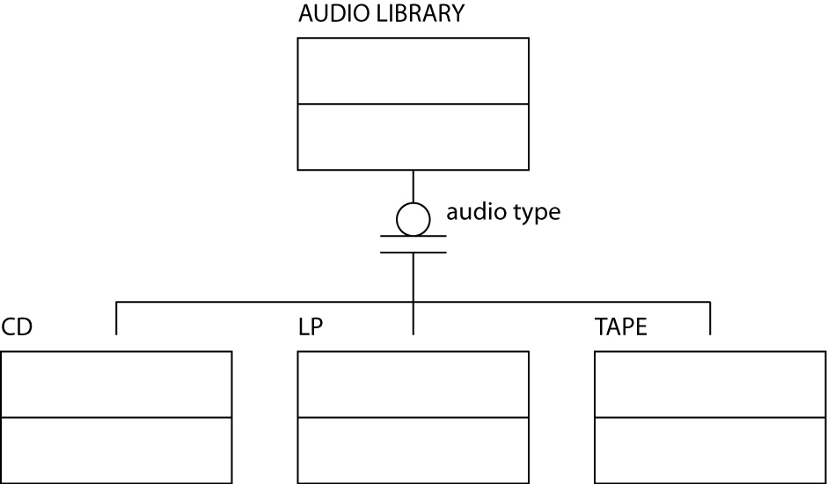
IDEF1X
Generalization hierarchy

Slide 23
Representing relationships
The various dialects are most distinctive in the ways in which relationships are represented
Mandatory or optional
Cardinality

Slide 24
Mandatory or optional relationship
Does an occurrence of this entity require an occurrence of the other entity?
Consider sale order and item
  Item is mandatory for a sales order
  Sales order is optional for an item

Slide 25
Cardinality
Cardinality |  | Meaning
0,1 | Optional | There can be zero or one occurrence of the entity relative to the other entity
0,n |  | There can be zero or many occurrences of the entity relative to the other entity
1,1 | Mandatory | One occurrence of the entity has one occurrence relative to the other entity
1,n |  | One occurrence of the entity can have many occurrences relative to the other entity

Slide 26
Goal
Learn to think like a data modeler
Different dialects and greater precision (e.g., cardinality) come easily once the basics are mastered

Slide 27
Key points
Normalization is one approach to data modeling
The are multiple representations for data model
Learning to model is difficult
Learning to represent a model is easy

